Slide 1
Application Demo and Progress Updates
Done by: G1T3

Slide 2

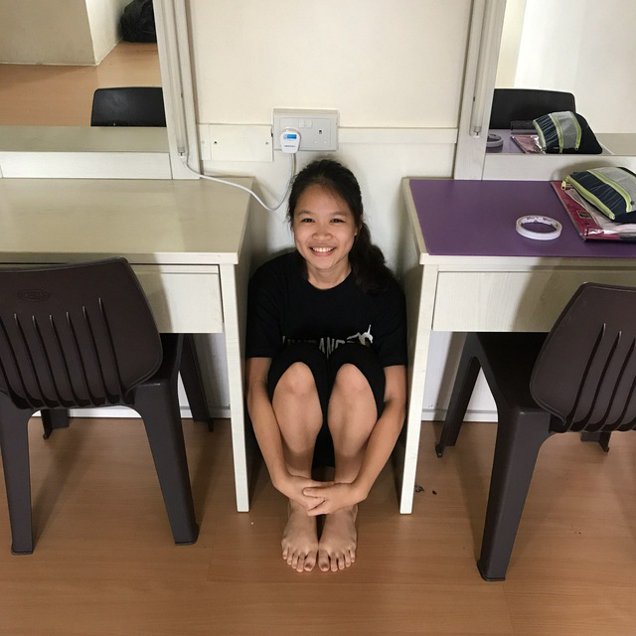



Team NO S.I.S.
Joleen
Amanda
Joel
Shreyas
Ming Xuan

Slide 3
Content page
Functionalities
Improvements made
Progress Updates and Schedule
Metrics
Roles & responsibilities
Notes:
Spill-overs → mitigation

Slide 4
1.1 Application Functionalities
Login
Bootstrap
Heatmap
Basic Location Report
Automatic Group Detection
Dual Interfaces (UI and Web Services)
Our group does not intend to drop any functionalities.

Slide 5
1.2 Chosen Framework
Model View Controller
Benefits:
Individual pages would face less complexity
Lesser interaction between the UI and Java
Easier separation of roles for pair programming

Slide 6
Improvements Made
From PM REVIEW

Slide 7
2.1 Updating Schedule
Issues | Improvements
Too much slack (5-6 days) between iterations causes each iteration to feel too rushed. | Improved time management by spreading range of tasks across the full time frame available for each iteration. (Not more than 3 days of slack)
Some tasks were over generalized. | Broke down general tasks into detailed sub-tasks to better account for project progress .
Lack of test planning especially after deployment. | Added testing phase after deployment to ensure that deployed application runs smoothly.

Slide 8
2.2 Updates on metrics
Issues | Improvements
Missing task metric documents in git repository | Added in missing task metric documents to ensure clarity in tracking of progress.

Slide 9
Schedule
Broad iteration Updates

Slide 10
3.1 Previous Iteration Overview
Iteration 1
Iteration 2
Iteration 3
Iteration 4
Iteration 5
Iteration 6
Iteration 7
Login
S.B. Report
Top K people report
UAT
A.G.I
Planning
Final Presentation
Bootstrap Function
Top K Popular Place report
Top K next place report
Heat Map
Submission
Notes:
Old Iteration Overview

Slide 11
3.2 New Iteration Overview
Iteration 1
Iteration 2
Iteration 3
Iteration 4
Iteration 5
Iteration 6
Iteration 7
Login
S.B. Report
Advanced S.B. Report
UAT
Top K Functions
Post UAT updates
Final Presentation
Planning
Heat Map
Bootstrap
Bootstrap
Validation
A.G.I
Submission
Notes:
New updated iteration overview.

Slide 12
3.3 Updates in New Iteration
Actions Taken | Reasons
Bootstrap functionality was stretched through 2 iterations. | Bootstrap validation task was a spillover from iteration 2 to 3.
Student Breakdown Report was spilt into basic and advanced functionality. | Advanced function was a spillover function from iteration 3 to 4.
Shifted all Top K functions into iteration 5. | Similar functionality easier to be done together.
Notes:
Added slide to explain changes in iteration tasks

Slide 13
Schedule
Updated Iteration Timeline

Slide 14
Iteration No | Week | Period | Start Date | End Date | Milestones/Tasks Done
Iteration 1 | Week 2 Week 3 | 14 days | 29/08/2017 | 12/09/2017 | Determine Schedule Backbone Design Diagrams Setting Metrics
Iteration 2 | Week 4 Week 5 | 14 days | 13/09/2017 | 26/09/2017 | Design Diagrams Login Bootstrap
Iteration 3 | Week 6 Week 7 | 14 days | 27/09/2017 | 10/10/2017 | Bootstrap Validation Supervisor Meeting 1 Basic Student Breakdown Report Web UI JSON Authenticate PM Review AWS Deployment
Iteration 4 | Week 8 Week 9 | 14 days | 11/10/2017 | 24/10/2017 | Advanced Student Breakdown Report Heat Map Automated Group Identification (AGI) JSON Bootstrap AWS Deployment Preparation for Application Demo

Slide 15
Iteration No | Week | Period | Start Date | End Date | Milestones/Tasks Done
Iteration 5 | Week 10 Week 11 | 14 days | 25/10/2017 | 07/11/2017 | Supervisor Meeting 2 Top k functions JSON Heat Map JSON AGI JSON Top k Functions AWS Deployment Application Demo
Iteration 6 | Week 12 Week 13 | 14 days | 08/11/2017 | 21/11/2017 | UAT Post UAT application improvements AWS Deployment Final Presentation Preparation Submission
Iteration 7 | Week 14 | 1 day | 22/11/2017 | 22/11/2017 | Presentation

Slide 16
Schedule
Progress Updates

Slide 17
3.4 What have we done?
Current Iteration:
Iteration 4 (End date 24th October)
Application Functions
Login
Bootstrap
Student Breakdown Report
Heat Map
AGI
JSON Authenticate
JSON Bootstrap
Uncompleted Application Functions
Top K functions
JSON for other Features

Slide 18
3.4 What have we done?
Milestones completed
PM Review
Supervisor Meeting 1
Preparation of App Demo
Milestones left
App Demo
Supervisor Meeting 2
Preparation for UAT
UAT
App Submission
Preparation for Final Presentation
Final Presentation

Slide 19
3.5 Challenges Faced – Spill over
Tasks Spilled Over | Problem | Action Taken
Advanced breakdown 2 requests | Had issues with functionality of Student Breakdown Report - storing of intermediate values of raw count values and percentage values when user selected two or three options for breakdown report. Printing of the results on the view page appropriately based on the user’s choice of option. | We planned for the tasks to be completed in the early half of iteration 4. The programming pair for the spillover task was in charge of completing the spillover task.
Advanced breakdown 2 requests and Chart for one request
Advanced breakdown 3 requests and output for two and three requests
Testing of Advanced Breakdown request
Debugging of Advanced Breakdown

Slide 20
Schedule
Critical path

Slide 21
Iteration 3 Critical Path: 12 days , Slack: 2 days
Deployment
Planning
Testing
Supervisor Meeting 1 (1 day)
PM Review (1 day)
Student breakdown request debugging (1 day)
Deployment on AWS and debug (1 day)
Bootstrap debugging (2 day)
PM Review Preparation; Creating Test cases, Update Test plan (1 day)
Overall functions testing & debugging (1 day)
Coding
Validation Location Lookup(1day)
Advanced breakdown 3 requests (1
day)
Integration
Validation location(1 day)
Validation demographics(1day)
UI Design (1 day)
Develop JSON Authenticate
(1 days)
Integrate required functions with previous functions (2 day)
Basic Location Report, Location DAO)
(1day)
Student breakdown one request(2 day)
Advanced Student breakdown two request(1day)
Advanced student breakdown 3 requests (1
day)

Slide 22
Iteration 4 Critical Path: 14 days
Planning
Testing
Testing after deployment (1 day)
AGD Debugging
(1 days)
Overall functions testing & debugging (1 day)
Create test cases (1 day)
Heat Map Debugging
(1 days)
Debugging after AWS testing(1 day)
Update test plan (1 day)
Coding
Deployment
Heat Map Servlet
(1 days)
Develop JSON Student Breakdown report
(1 days)
Redeployment on AWS (1 day)
Deployment on AWS
(1 day)
Heat Map Request Page
(1 day)
Heat Map Interface /UI
(1 days)
Heat Map DAO
(2 days)
Integration
AGD request Page
(1 day)
AGD Servlet
(1 day)
Integrate search classes with previous functions (1 day)
AGD DAO
(2 day)
AGD Interface
(1 day)

Slide 23
Iteration 5 Critical Path: 11 days, Slack: 3 days
Planning
Deployment
Supervisor meeting 2
(0.5 day)
Deployment on AWS and testing (1 day)
Redeployment on AWS for UAT(1 day)
Demo of prototype and progress update (0.5 day)
Create test cases (1 day)
Testing
Update test plan (1 day)
Overall functions testing & debugging (1 day)
Debugging for bugs found on AWS test (1 day)
Coding
Update Top K DAO-
Top K next place report
(1 day)
Update Top K DAO –
Top K people report
(1 day)
Top K reports debug
(1 days)
Update basic location report Servlet (1 day)
Create Top K DAO -
Top K places
(1 day)
Integration
Develop JSON Heat Map
(1 days)
Develop JSON AGI
(1 days)
Develop JSON Top K
(1 days)
UI – Improve Usability
(1 days)
Integrate improved UI with previous functions (1 day)

Slide 24
Iteration 6 Critical Path: 11 days, Buffer: 3 days
Planning
Design
Final Presentation Slides (1 day)
Manual UAT in class and automated UAT (1 day)
Integration
Deployment
Integrate improved UI with previous functions (1 day)
Deployment on AWS
(1 day)
Coding
Testing
Overall functions testing and debugging
(2 days)
Final Deployment on AWS
(1 day)
Post- UAT Improve application (3 days)
Enhance UI (3 days)
Testing and debugging after deployment
(1 day)
Final Submission
(1 day)

Slide 25
Iteration 7 Critical Path: 1 Days
Planning
Final presentation rehearsal
(0.5 day)
Final presentation
(0.5 day)

Slide 26
Metrics
Task metrics

Slide 27
4.1 Task Metric Results
Iteration | No. of Planned Tasks | Total no. of Tasks | Completed Tasks | Uncompleted Tasks | Result
1 | 10 | 12 | 12 | 0 | 1.2
2 | 18 | 20 | 15 | 5 | 0.83
3 | 24 | 28 | 22 | 6 | 0.92
4 | 31 | 31 | On going | On going | On going

Slide 28
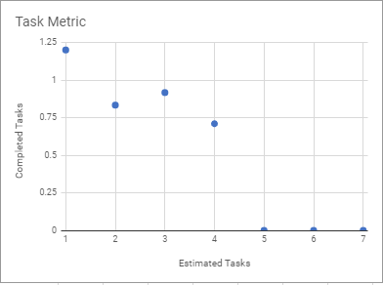
4.2 Task Metric Graph
Lesson Learnt:
With improvements made in task management after underloading in iteration 1 and overloading in iteration 2, we managed to keep our task metric between 90% to 110%

Slide 29
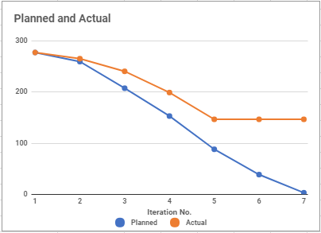
4.3 Burndown

Slide 30
Metrics
bug Metrics

Slide 31
4.4 Bug Metric Results
Iteration | No. of low impact Bugs | No. of high impact bugs | No. of critical impact bugs | Total severity points | Bugs carried to next iteration
1 | 0 | 0 | 0 | 0 | 0
2 | 0 | 0 | 1 | 10 | 0
3 | 1 | 4 | 2 | 41 | 0
4 | 0 | 3 | 1 | 25 | On-going

Slide 32
Roles and Responsibilities
Rotation plan

Slide 33
5.1 Task Distribution
Functions | Joel | Shreyas | Ming Xuan | Amanda | Joleen
Login Authentication |  |  |  | ✓ | ✓
Bootstrap | ✓ |  | ✓
Validations of csv files | ✓ |  |  |  | ✓
Student breakdown report |  | ✓ | ✓
Heat Map |  | ✓ |  |  | ✓
Automated Group Identification | ✓ |  |  | ✓
Dual Interface | ✓ |  | ✓
Top k report |  | ✓ |  | ✓
UI – Develop |  | ✓ | ✓
UI – Improve Usability | ✓ |  | ✓
UI – Enhance |  |  |  | ✓ | ✓

Slide 34
5.2 Rotation Plan
Iteration | Week duration | PM | Pair Programming 1 | Pair Programming 2
1 | 2-3 | Joel | - | -
2 | 4-5 | Shreyas | Amanda, Joleen | Ming Xuan, Joel
3 | 6-7 | Amanda | Joel, Joleen | Ming Xuan, Shreyas
4 | 8-9 | Ming Xuan | Joel, Amanda | Shreyas, Joleen
5 | 10-11 | Joleen | Joel, Ming Xuan | Shreyas, Amanda
6 | 12-13 | Shreyas | Amanda, Joel | Ming Xuan, Joleen
7 | 14 | Joel | - | -

Slide 35
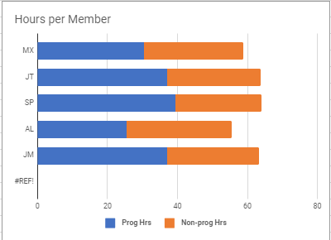
5.3 Current Work Hours Breakdown

Slide 36
5.4 Remaining PM Milestones
Supervisor Meeting 2 (25/10/2017) - Joleen
Application Demo and Progress Update (25/10/2017) – Joleen
UAT Deployment (5/11/2017) - Joleen
UAT In-class (8/11/2017) – Shreyas
Final Submission (19/11/2017) – Shreyas
Final Presentation (22/11/2017) – Joel

Slide 37
THE END
G1T3

